Slide 1
Recycling Diversion
By-
DC20029

Slide 2
Background
In New York City, Recycling Diversion rate and Capture Rate Capture are collected for each zone and district. This ratio measures how much of the targeted materials are being recycled, which is a measure of how successfully such materials are recycled.

Slide 3
Deliverables
EDA of which district recycles the most for the different type of recycling wastes?

Slide 4
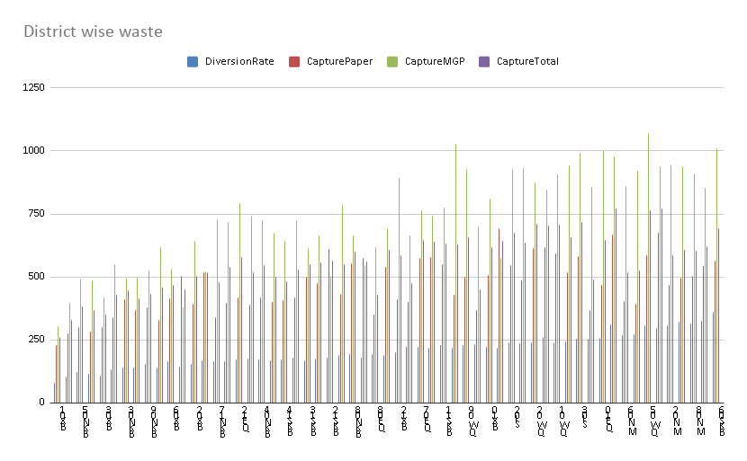

Slide 5
Deliverables
2. EDA to which type of recycling waste is collected at high rates?

Slide 6
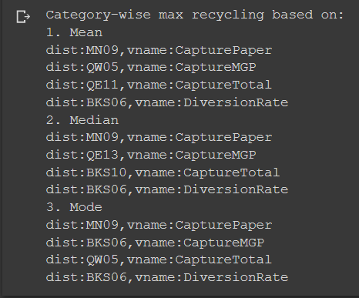

Slide 7
Deliverables
3. EDA of what month is recycling lower or higher?

Slide 8
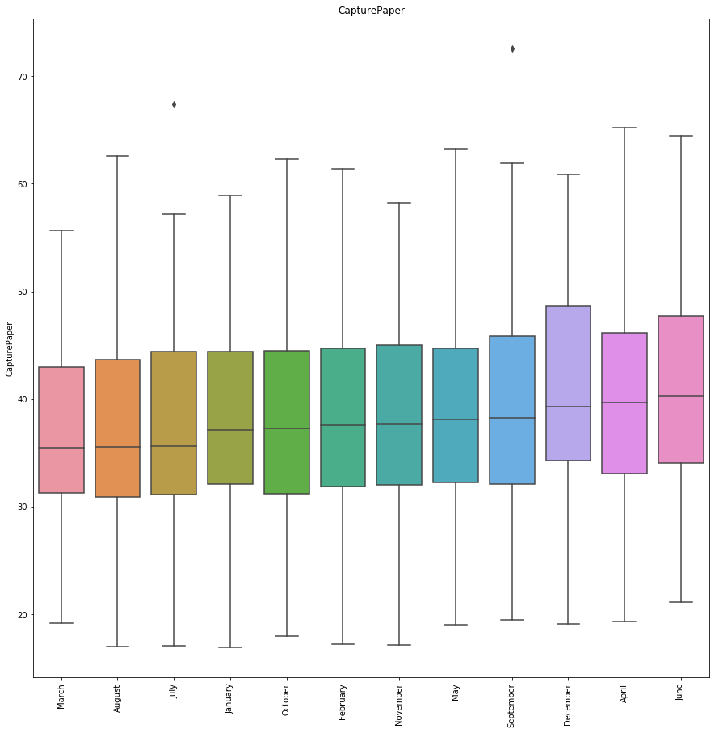

Slide 9
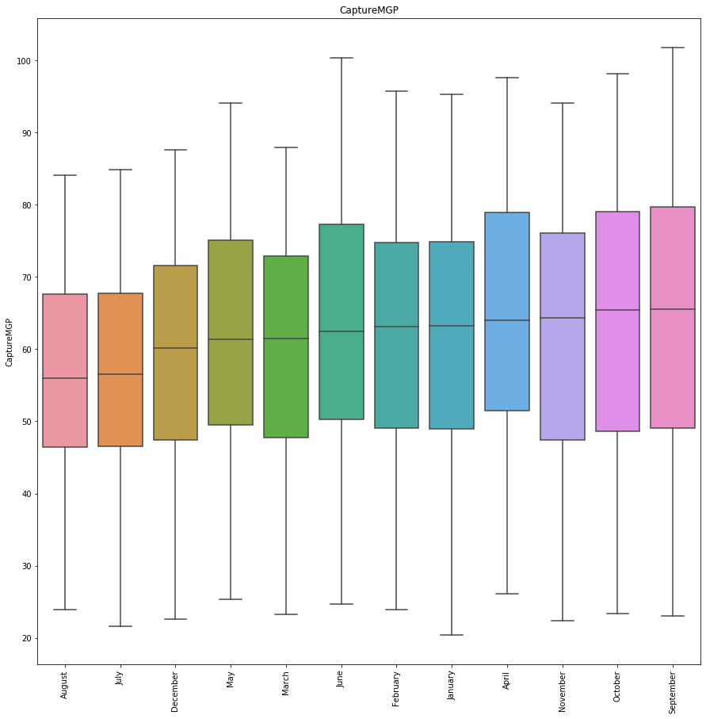

Slide 10
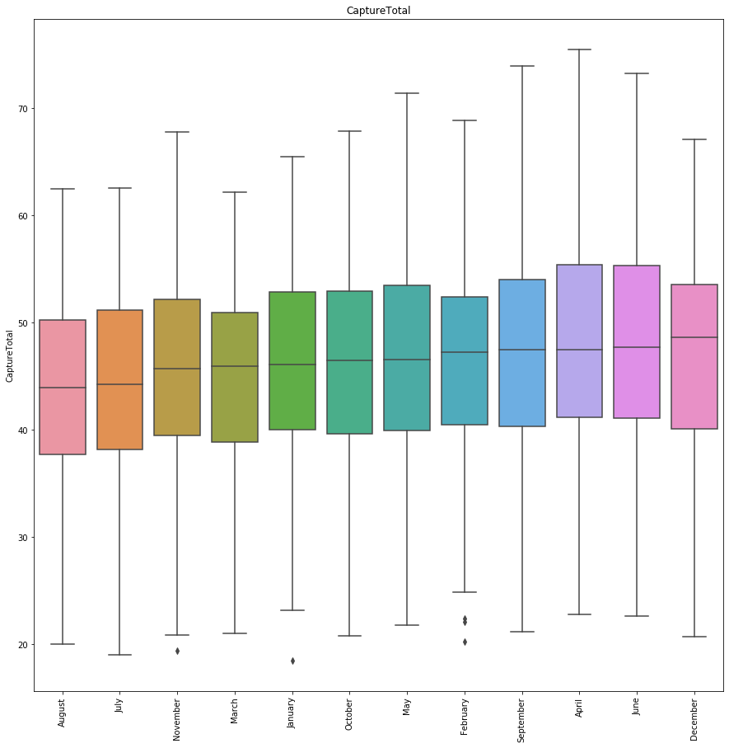

Slide 11
Data Prediction
Use Machine learning to predict the amount of recycling that will be collected for a specific zone.
Classical methods ike ARIMA out-perform machine learning for time series forecasting.
Machine Learning methods do not deliver as they promise.

Slide 12
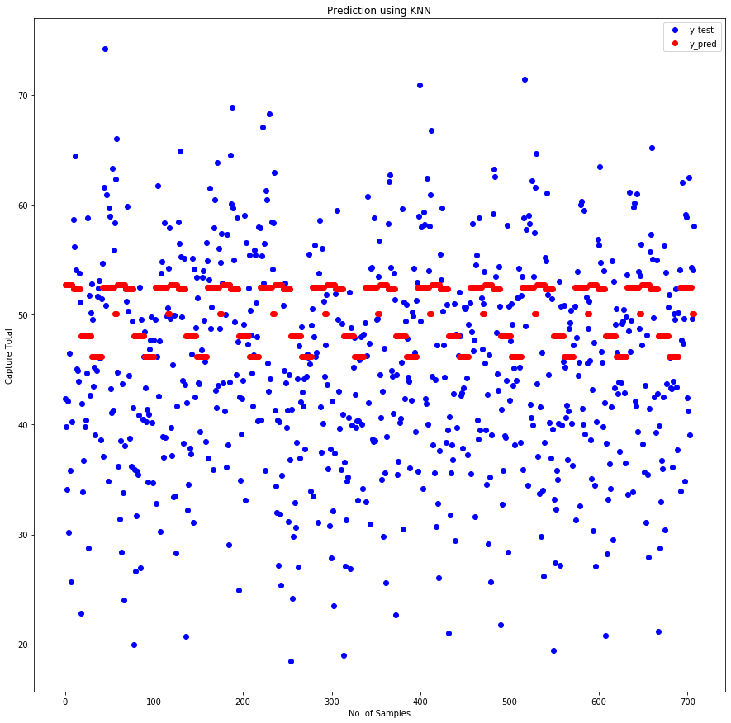

Slide 13
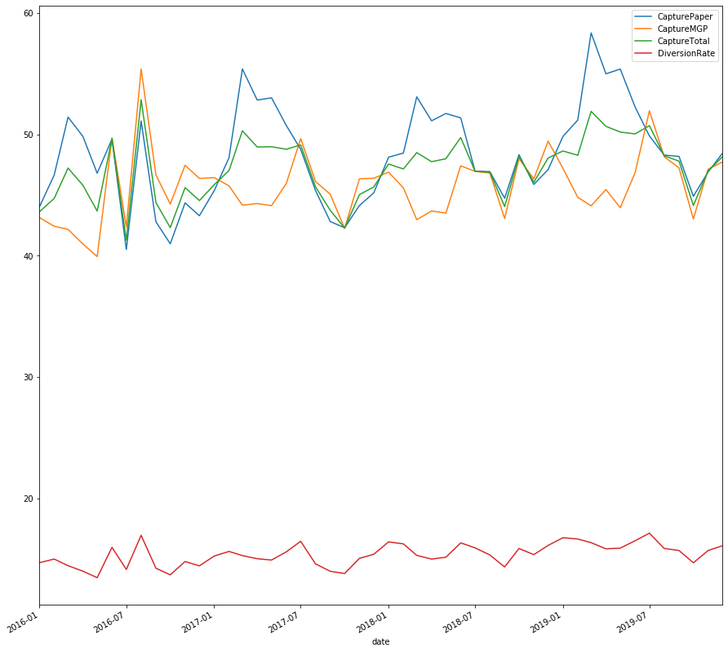

Slide 14
Conclusion
Using machine learning, we are not able to get accurate data because the data is limited for the time series we got.

